Slide 1


PROJECT PRESENTATION ON
Notepad
SEM – III
GUIDE – PROF. DAKSHATA ARGADE
STUDENTS :
TU4S2122006 / A-72 /RACHIT PATIL
TU4S2122007 / A-73 /SHUBHAM MANKAR
TU4S2122010 / A-75 / PRASAD KASHID
TU4S2122012 / A-77 / HARSHVARDHAN DESAI
DEPARTMENT OF INFORMATION TECHNOLOGY

Slide 2
OUTLINE
Introduction
Literature Review
Problem Statement
Proposed Solution
Designing of System
Conclusion
DEPARTMENT OF INFORMATION TECHNOLOGY

Slide 3
INTRODUCTION
Notepad is a simple text editor.
A basic text-editing program which enables computer users to create documents.
Notepad is a text editor and source code editor for use with Microsoft Windows.
The application is a text editor in Java. This text editor developed in Java
platform is a replication of the word editors. We all are familiar with and which
we use quite often on a daily basis.
This editor has been created using Java for the Front end interface.
The text edited in the editor is stored in the desired location.
This application contains some basic features like open file, save file.
DEPARTMENT OF INFORMATION TECHNOLOGY

Slide 4
LITERATURE SURVEY
EXISTING SYSTEM (RESEARCH PAPER CITATIONS)
2019 IEEE 9th International Conference on System Engineering and Technology (ICSET), 7th October 2019, Shah Alam, Malaysia.
ATM Reporting System,
Umi Najiah Ahmad Razimi, Falah Younis Ahmed, Nordiana Rhahayu Mustapa.
Faculty of Information Science and Engineering, Management and Science University
Seksyen 13, 40100 Shah Alam, Selangor, Malaysia.
Description of the Research Paper:
Java Programming benefits users to collaborate with the external languages to be in
one file. Java is a general-purpose of computer-programming language that is
concurrent, class-based, and object-oriented. It specifically was designed to have a
few implementation dependencies as possible.
From the above research paper we also understood the basic Sequence Diagram of
the ATM and flow of its process.
DEPARTMENT OF INFORMATION TECHNOLOGY

Slide 5
LITERATURE SURVEY
EXISTING SYSTEM (RESEARCH PAPER CITATIONS)
2017 Third International Conference on Science Technology Engineering & Management (ICONSTEM).
An Extensive Resolution Of ATM Security Systems.
Jacintha V M.E(Ph.D), Assistant Professor (ECE Department), Jeppiaar Maamallan
Engineering College.
Jamuna Rani S, Glory Beula J, Jeba Johnsly J, Students (ECE Department), Jeppiaar
Maamallan Engineering College.
Description of the Research Paper:
From the above research paper it is clear that various techniques are available to
avoid robbery in ATM. We have reviewed different approaches by different
researchers for ATM monitoring and security.
The Overall aim of this analysis provides various methods to secure the ATM.
DEPARTMENT OF INFORMATION TECHNOLOGY

Slide 6
LITERATURE SURVEY
EXISTING SYSTEM (RESEARCH PAPER CITATIONS)
International Journal of Innovative Technology and Exploring Engineering (IJITEE) ISSN: 2278-3075, Volume-8, Issue-9S3, July 2019.
Automated Teller Machine System,
S.Pothumani, G.Kavitha, G.Michael.
Department of Computer Science and Engineering, Bharath Institute of Higher
Education and Research, Chennai.
From the above Reference paper we studied about the different system modules
used in the project and it’s scope. The majors areas to be considered while
determining the feasibility of a system were also studied along with the formal design
model of ATM.
DEPARTMENT OF INFORMATION TECHNOLOGY

Slide 7
LITERATURE SURVEY
EXISTING SYSTEM (RESEARCH PAPER CITATIONS)
Volume 3, No. 1, Jan-Feb 2012, ISSN No. 0976-5697,
International Journal of Advanced Research in Computer Science .
Development of Automated Teller Machine System Using JAVA.
Surajit Borah, Shinjit Kamal Borah.
B. Tech-Computer Science and Engineering Department of Computer Science and
Engineering Shillong Engineering and Management College Meghalaya, India-793101.
Volume 2, Issue 4, April 2014, ISSN: 2321-7782,
International Journal of Advance Research in Computer Science and Management Studies.
Secured Automatic Teller Machine (ATM) and Cash Deposit Machine (CDM).
Shailesh N. Sisat, Vishwajit K. Barbudhe, Prajkta S. Bhopale.
Dept. of Electronics & Telecommunication, G. H. Raisoni C. O. E. & M., Amravati
Maharashtra – India.
DEPARTMENT OF INFORMATION TECHNOLOGY

Slide 8
PROBLEM STATEMENT
Consider a situation that you need to view a important text file quickly and
urgently. We have to check whether there are any mistakes in that text file. For this purpose, Notepad is very useful application. Due to Notepad application, you can not even view the file but also recorrect the mistakes that has to be solved.
Objective
The main objective was to study Java programming by developing a
notepad. A notepad i.e. a text-editor is a computer program that lets a user enter,
change, store, and usually print text (characters and numbers).
DEPARTMENT OF INFORMATION TECHNOLOGY

Slide 9
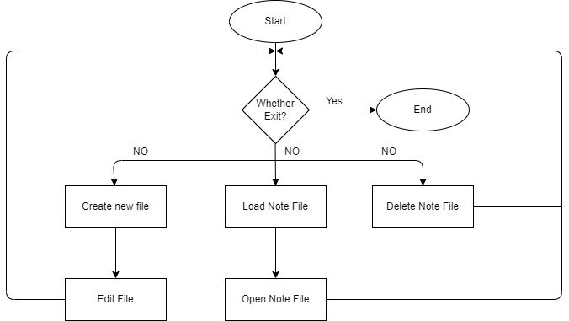
FLOW CHART
DEPARTMENT OF INFORMATION TECHNOLOGY

Slide 10
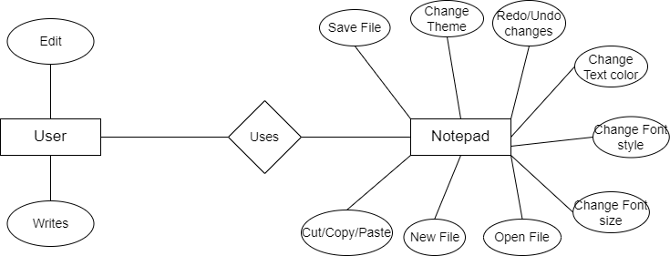
ER DIAGRAM

Slide 11
EMPLOYEE MODULE
Here the employee can login, register and can apply for leave.
The employee can check the status of leaves applied and view all applied leaves.
ADMIN MODULE
Here admin can create employee account and approve, reject or delete employee’s leave request.
DEPARTMENT OF INFORMATION TECHNOLOGY

Slide 12
RESULTS AND DISCUSSIONS
Snapshot of GUI design of project
DEPARTMENT OF INFORMATION TECHNOLOGY

Slide 13
DEPARTMENT OF INFORMATION TECHNOLOGY

Slide 14
DEPARTMENT OF INFORMATION TECHNOLOGY

Slide 15
DEPARTMENT OF INFORMATION TECHNOLOGY

Slide 16
DEPARTMENT OF INFORMATION TECHNOLOGY

Slide 17
DEPARTMENT OF INFORMATION TECHNOLOGY

Slide 18
CONCLUSION
Here we conclude our lines of our mini project on the topic ‘Notepad’ with
the extreme satisfaction and contentment. This report consists brief definition of
Notepad together with its features and functions.
Added to this, this report contains the basic description to create, edit,
save, delete and exit from file through JAVA program. It is user friendly, which
can be used by the user to perform desired operations. It also includes practical
implementation of text editors through complex JAVA program.
DEPARTMENT OF INFORMATION TECHNOLOGY

Slide 19
REFERENCES
https://www.researchgate.net/publication/342815048_EMPLOYEE_LEAVE_MANAGEMENT_SYSTEM
https://capstoneguide.com/online-employee-leave-management-system-capstone-project-document/
DEPARTMENT OF INFORMATION TECHNOLOGY

